Slide 1
The Tools!
Getting setup for your first D3D or OpenGl application

Slide 2
Two Choices
So one route you can go is the C++, OpenGl, Vulkan etc. route. If you want to be an actual game or application programmer go this route, because at some point in your CS education you should learn something actually useful, and it may as well be now.
The other option is WebGL. We’ll get to that in a minute. WebGl is a really good idea and most of the graphics programming stuff is the same as C++ OpenGL.. That was the whole idea.
But WebGL has no option for vulkan, and while it makes early tutorial stuff easy, it makes the advanced concepts harder.

Slide 3
Lab Today
Today in the lab you should try both, just to get a sense of how all of this works
Note that I suggest we stick to openGL/ DirectX rather than Vulkan, Vulkan is a bit more complicated than we have room/time for

Slide 4
Tools you need, the C++ route
Cmake (cmake.org)
https://cmake.org/download/
OpenGL redbook samples – opengl-redbook.com
(http://www.opengl-redbook.com/OGLPG-9th-Edition.zip)
And visual studio 2013 or later.
This *should* maybe, if you’re lucky, kinda sorta work elsewhere.
It works on Visual studio 2017 (Sri tested FA 2018)

Slide 5
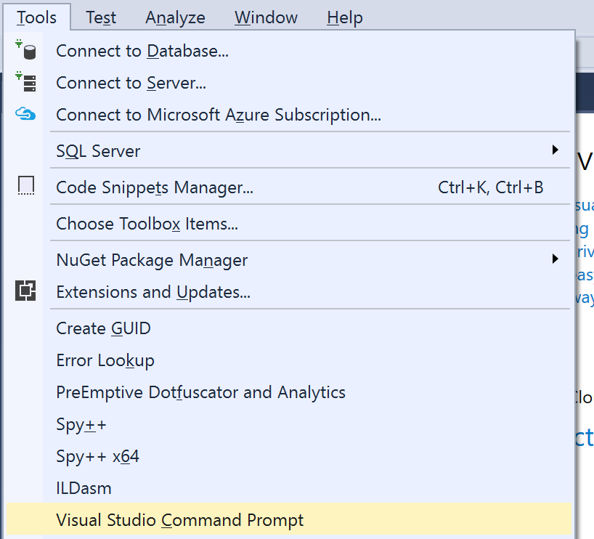
Open Up Visual Studio
Notes:
Go to Tools menu, visual studio command prompt

Slide 6
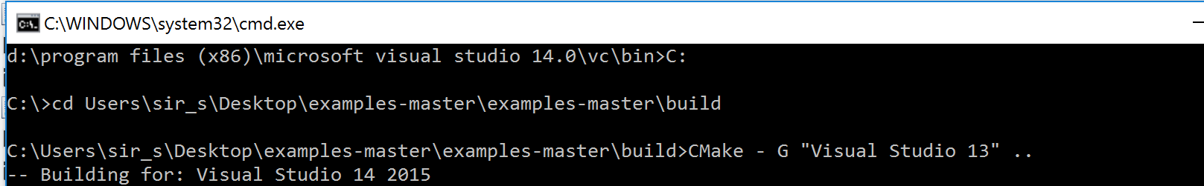

Slide 7
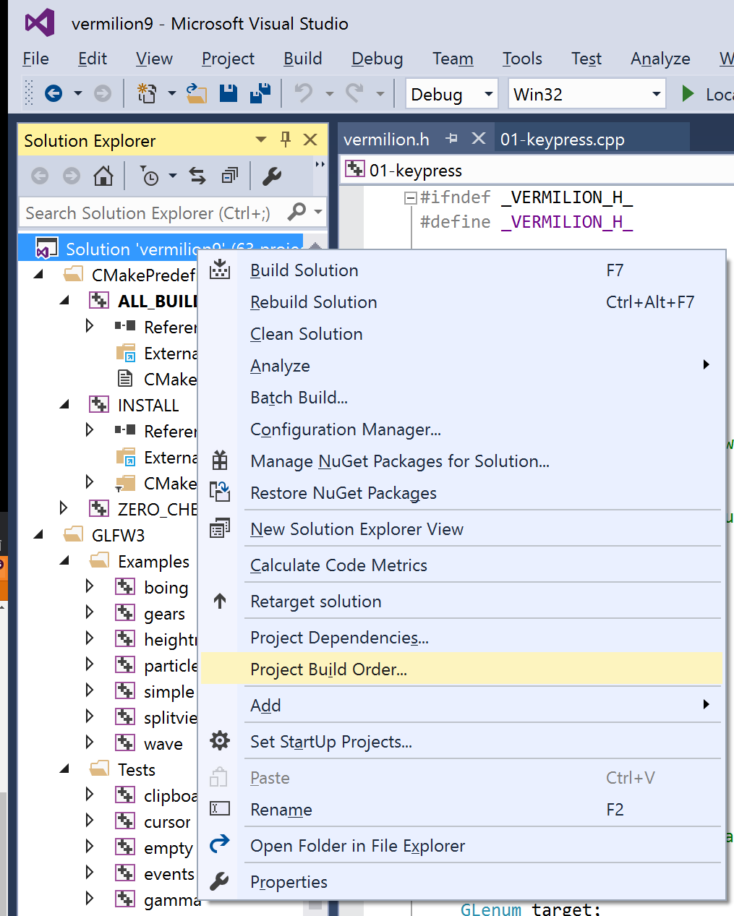

Slide 8
Dependencies
Change Vermillion to depend on GLFW
(Otherwise it doesn’t build things in the right order and then none of the applications can link to GLFW and nothing works)
Then build solution

Slide 9
And you get a bunch of programs that.. .don’t work?
No, actually, they do
The .exe’s are just all in examples-master\bin rather than
examples-master\build\01-keypress.dir\Debug where they should be
I didn’t have time to try and fix that

Slide 10
The WebGL route
Make sure you have a web browser that doesn’t suck
You can copy and paste a simple sample from somewhere (e.g. tutorialspoint has one
https://www.tutorialspoint.com/webgl/webgl_sample_application.htm
That will give you a triangle.

Slide 11
Both: The OpenGL pipeline
Prepare Vertex data (usually in an array which is then passed to a vertex buffer object)
Transform vertices according to the vertex shader. More on this next week but it’s thinks like we talked about last class, rotation scaling etc.
Some stuff happens to convert vertex transformations happen to get things clipped and into the correct coordinate system
Your GPU assembles some (primitive) data structures it can work with and culls back facing polys
Generation of raster fragments… normal people call these pixels
Fragment operations (you program)
Per fragment processing

Slide 12
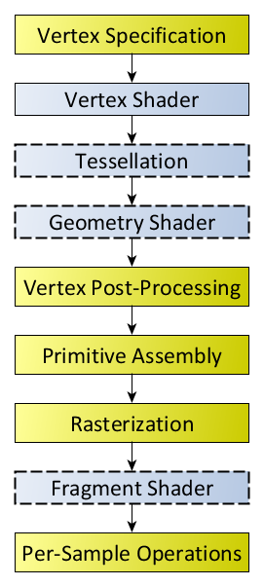
Diagram of the Rendering Pipeline. The blue boxes are programmable shader stages
Notes:
https://www.khronos.org/opengl/wiki/Rendering_Pipeline_Overview

Slide 13
A minor note
Because real programs have many objects with many shader programs all being applied to each other, part of those stages is correctly attaching the shader to the thing it belongs with
But that isn’t actually a problem for obvious reasons (since you program it to use a particular shader).

Slide 14
Shader?
A shader is a very short program that does a specific type of thing
These started in 1988 (Ed Catmul, Pixar), as being related to shadows but the concept of a code snippet that works on a specific part of the pipeline caught on.
There are still fragment/pixel shaders for shadow effects.
But as per the diagram a couple of slides back, there are other shaders now too

Slide 15
Vertex Shader
Vertex shaders transform the position, and potentially the colour and texture coordinate of a particular vertex. Every vertex has at least one shader operation every time a frame is drawn.

Slide 16
Vertex Shader
A simple vertex shader
#version 400 core
layout( location = 0 ) in vec4 vPosition;
voidmain()
{
gl_Position = vPosition;
}
So a vertex has a position (vPosition) and that’s the one openGL will use to draw it…. Exciting!

Slide 17
Tessellation Shaders
Tessellation is a fairly advanced concept so we won’t look at code today
But tessellation allows you to generate or destroy geometry using math. So you can generate more polygons for something close to the screen for example.
It also cuts down on memory use by allowing work to be done in a shader stage rather than trying to down sample from different models in memory

Slide 18
Geometry Shader
If a tessellation shader can improve the quality of the mesh of an object a geometry shader can generate entirely new primitives.
Useful applications include instancing (duplicating objects), or outputting the same vertex data to multiple places, if it’s shared for example.
Also useful for some environment mapping

Slide 19
Fragment (pixel) Shader
Produces a colour and a depth value
If you skip the colour part and combine with other fragment shaders you can do some shadow effects
Fragment shaders are primarily about applying textures to things.

Slide 20
Fragment Shader Example
#version 450 core
out vec4 fColor;
void main()
{
fColor = vec4(0.5, 0.4, 0.8, 1.0);
}
So we have a simple fragment shader that will colour a pixel.. To well, a colour. (note that OpenGL specifies the spelling of colour wrong)

Slide 21
Colour as a 4 Vector
Red, Green, Blue, Alpha
RGB are between 0-> 1.0 and it’s the same as RGB 0-255 integers basically
Alpha is a transparency amount that for reasons we’ll get to later doesn’t see as much use in 3D anymore, but is still there.

Slide 22
WebGL vs OpenGL
Shaders in WebGL are based on the OpenGL ES 2.0 standard (embedded systems).
The actual shaders are the same, regardless of OpenGL or WebGl but do be careful that a few features of regular OpenGL and GLSL (the shader language) don’t actually work in the ES version
ES is popular on mobile, and is generally a subset of regular OpenGL so it’s pretty much the same for everyone.

Slide 23
Shaders in WebGL
Because Shaders in webGL only have 1 version
var vertCode =
'attribute vec2 coordinates;' +
'void main(void) {' + ' gl_Position = vec4(coordinates,0.0, 1.0);' + '}';
Is a full valid vertex shader and
var fragCode = 'void main(void) {' + 'gl_FragColor = vec4(0.0, 0.0, 0.0, 0.1);' + '}';
is a valid fragment shader

Slide 24
Shaders Are C/C++ … sort of
The language specification for shaders is basically from C/C++ but since they are generally fairly short that shouldn’t be a problem

Slide 25
OpenGL for the Desktop
OpenGL for the desktop on the other hand is mainly in C++
And if you don’t know anything about C++ you may find some things a bit more difficult as we go. But I recommend you do it anyway. The more languages you know the better.

Slide 26
Serious Non 4480H Talk
http://www.tiobe.com/tiobe-index/
If you want to make a living, learn how to do something useful in more than one language.

Slide 27
Today
Today is just making sure you know how to make stuff work and to debug it

